Slide 1
Guidance via Product Reviews
An analysis of price and user ratings in a saturated market
Alexander Tran, PhD

Slide 2
Products and product reviews
Consumers are “social animals” and base their decision-making process on others’ behavior (i.e. reliable, positive, product reviews or recommendations)
The problem: Wireless headphone products vary in quality, and the review process is not entirely reliable (bots/automated reviews)
The landscape: The market is highly saturated, with multiple possible products, AI bots flooding market with duplicate postings
A data-driven solution: Using webscraping, data-cleaning and visualization, one can try to find headphones on the upper end of quality

Slide 3
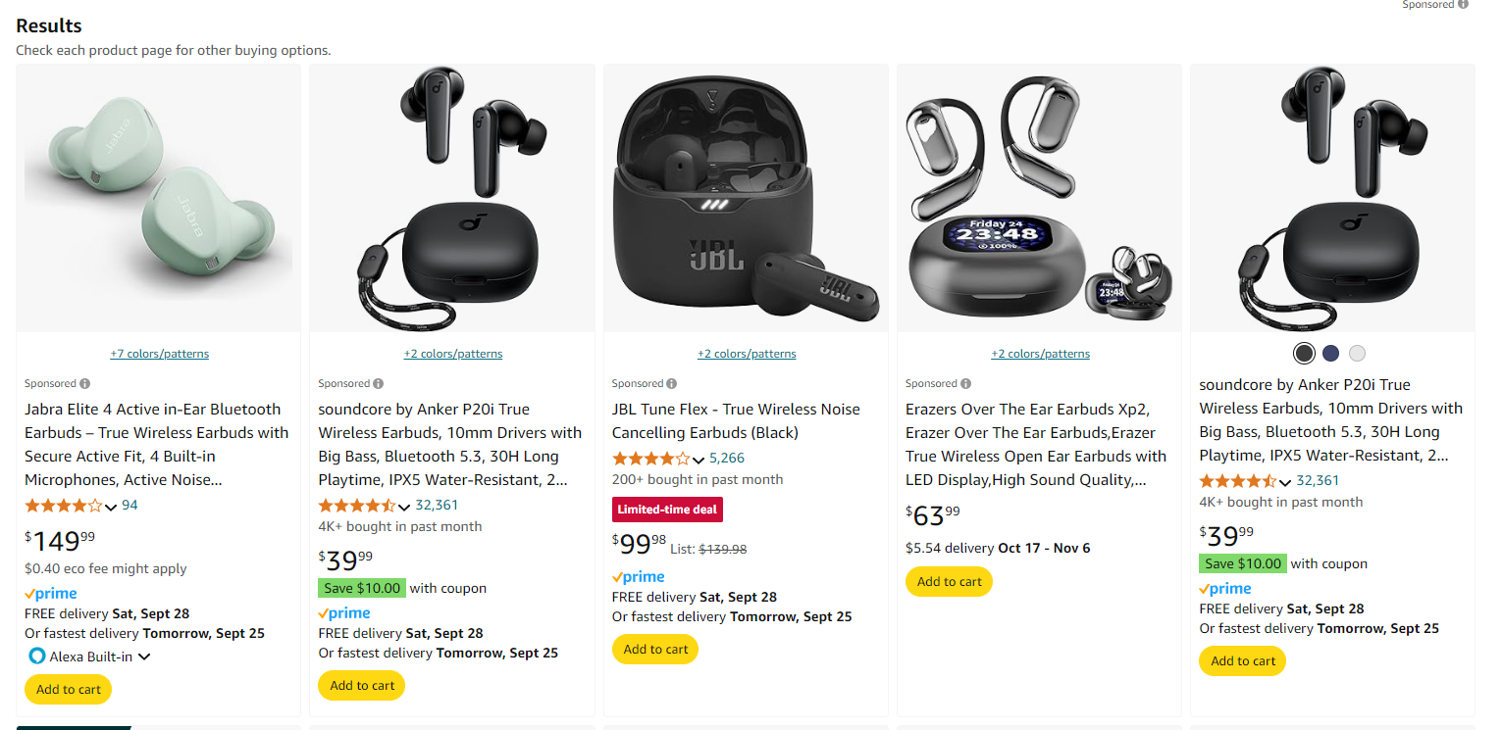

Slide 4
Solution: Step 1
Scraped data from “True wireless headphones” products on Amazon.ca for the first 15 pages, collecting: Price, Average Star Rating, Number of Reviews (n = 519; products/observations)
Visualized data using histograms; some skewed data in pricing, and outliers in Ratings and Reviews

Slide 5
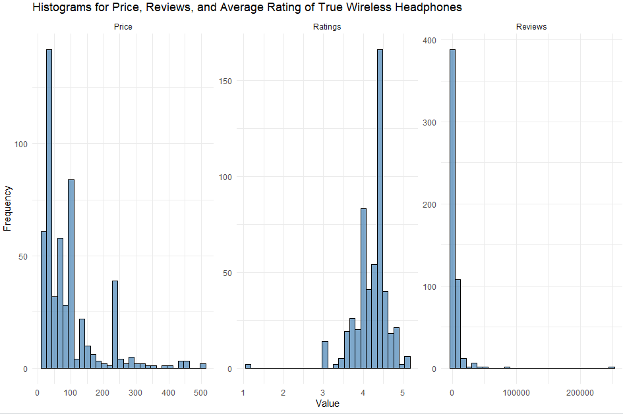

Slide 6
Solution: Step 2
Removed outliers and duplicates from the data (Reviews > 9,000, Star rating less than 3/5, n = 224)
Analyzed central tendencies;
Reviews
Mean # of reviews = 1366
Mode = 1 or 4 reviews (next highest number of reviews is 1079, and 58)
Median = 336 reviews
Price
Mean price = 92.85
Mode prices = 39.99 or 69.99
Median price = 49.99
Ratings
Mean rating = 4.16
Mode rating = 4.15 or 4.35
Median rating = 4.15

Slide 7
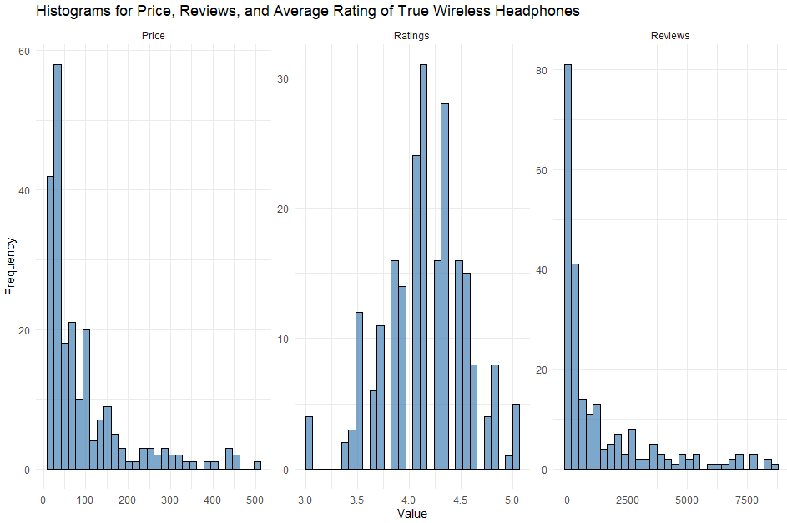

Slide 8
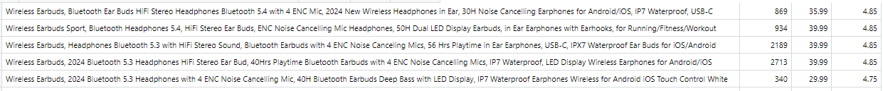
Solution: Step 3
Apply desired filter (n = 50);
Assuming price is not main factor (though in many cases it is)
Higher than median number of reviews (mean is not reliable as it is categorical and not a continuous variable; more than 336 Reviews)
Average Product Rating higher than 4.16

